Slide 1


History of
Windows OS
By Saidul Islam Badhon
COMT-200534
566306
Submitted to
Nigar Sultana

Slide 2
About Me
Key | Value
Name | Saidul Islam Badhon
Class Roll | Comt-200534
Board Roll | 566306
Reg. No. | 1502135678
Department | Computer Technology
Semester | 5th
Section | B
Batch | 5th
Hello everyone, and thank you for taking the time to leasing my presentation. Before I begin the presentation, let me tell you about myself.

Slide 3
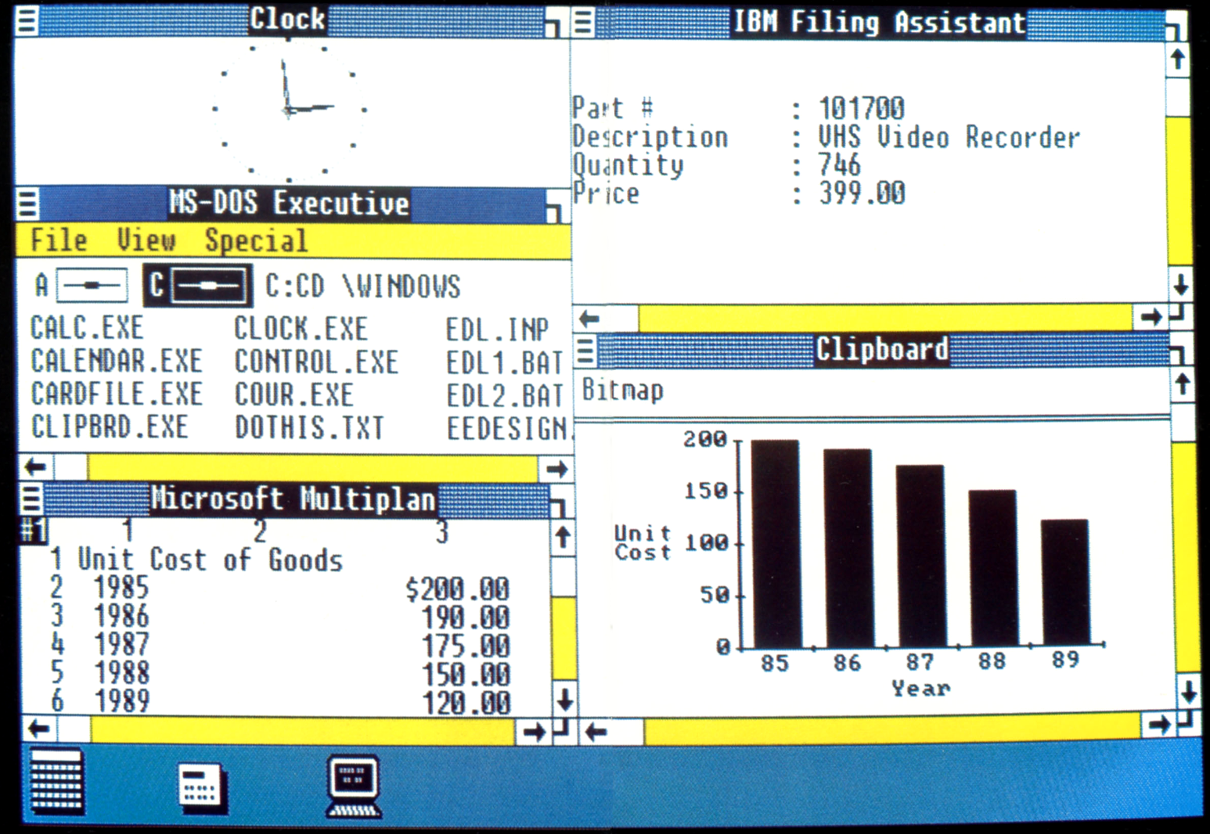
Windows 1.x
Pure operating environment
Used GUI (Graphical User Interface)
Simple graphics

Slide 4
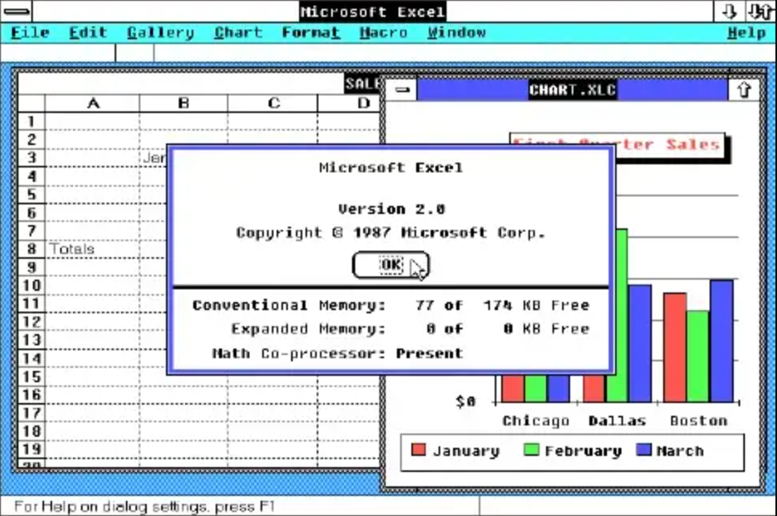
Windows 2.x
16-bit Microsoft Windows GUI-based operating environment
Faster than 1.x
Introduced the control panel
Introduced first version on exceland word

Slide 5
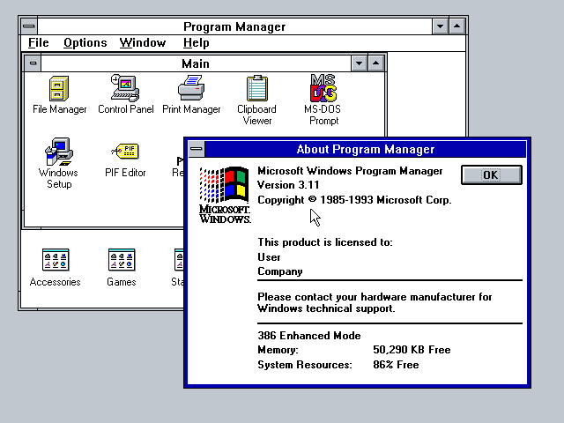
Windows 3.x
Operated with 8086 microprocessor
Virtual memory
Operated with 6-7 MB of free space of hard drive
Better multitasking

Slide 6
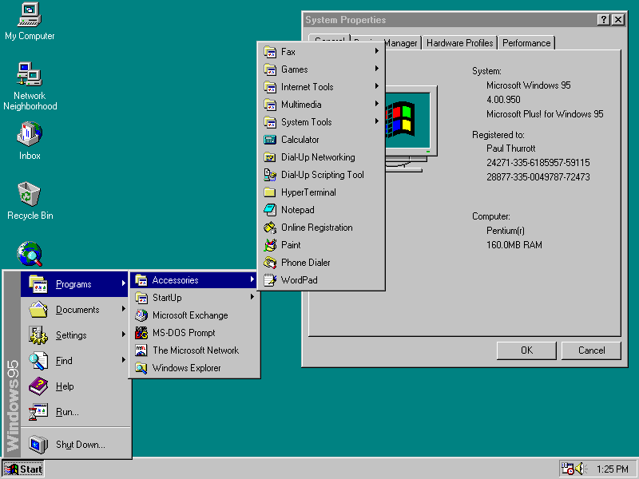
Windows 95
A complete operating system
Improved windows control and appearance
Right button menu
Taskbar and start menu

Slide 7
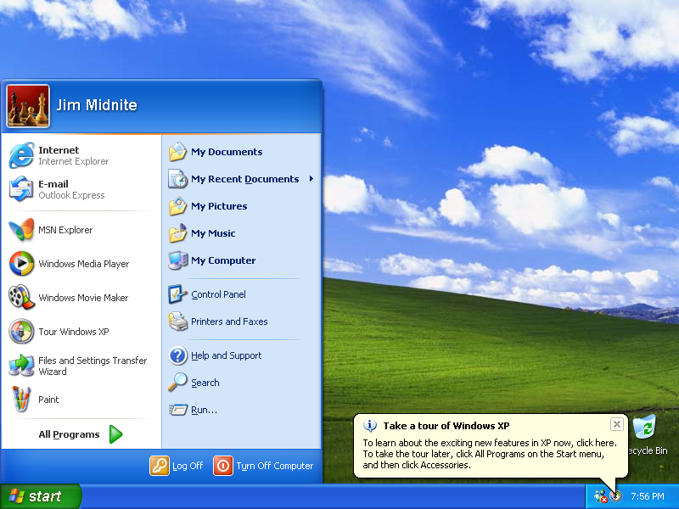
Windows XP
Advanced portable PC support
Automatic wireless connection support
Fast start-up
Help and support center
Better graphical user interface

Slide 8
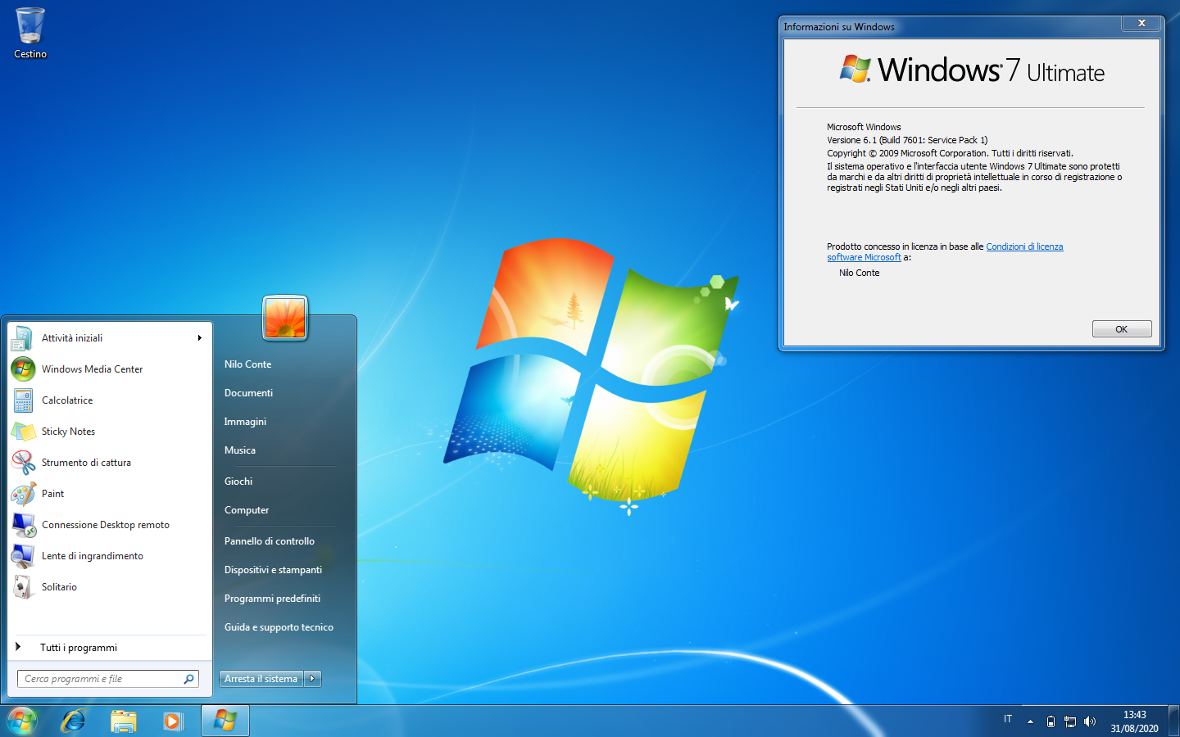
Windows 7
Introduced a large number of new features
Incremental upgrade to the Windows line
Windows 7 has multi-touch support
redesigned Windows shell with an updated taskbar
a home networking system called Home Group, and performance improvements.

Slide 9
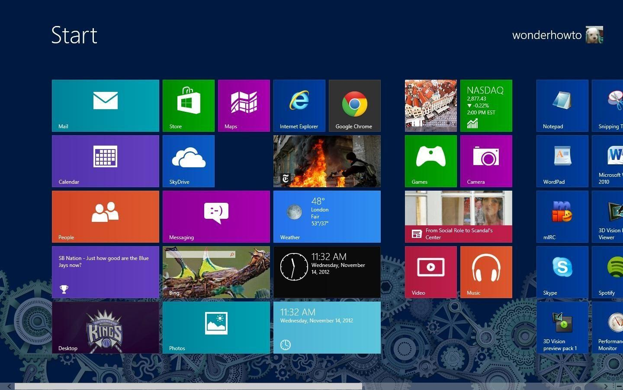
Windows 8
Optimizations for touch-based
Devices such as tablets and all-in-one pcs
Increased integration with cloud services
Other online platforms (such as social networks and microsoft's own onedrive (formerly skydrive) and xbox live services)
The Windows Store service for software distribution

Slide 10
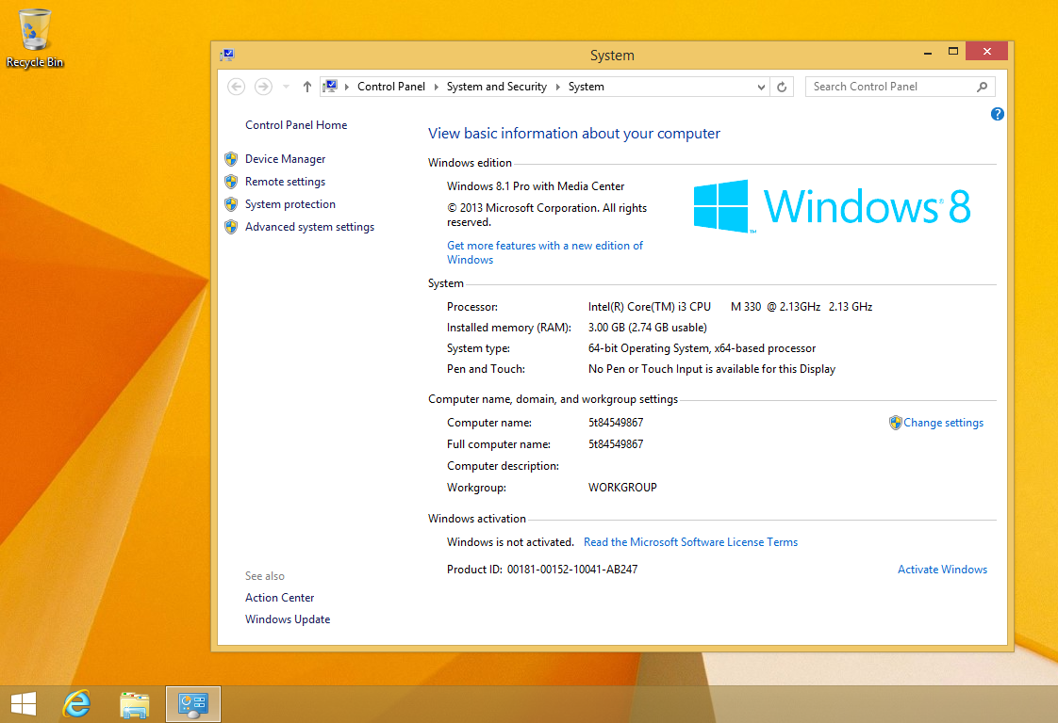
Windows 8.1
Fixed windows 8
Added Start Button
People Loved it

Slide 11
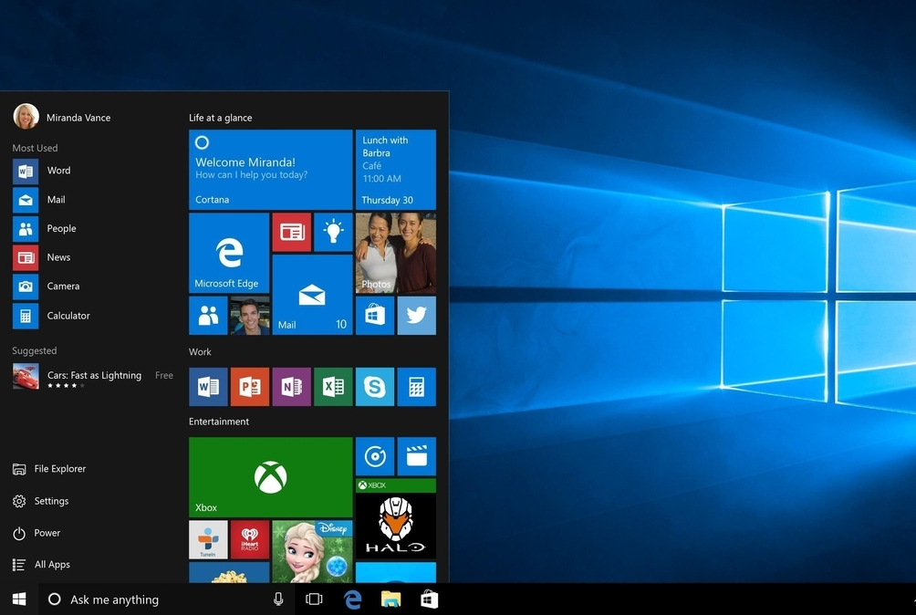
Windows 10
Addresses shortcomings in the user interface first introduced with windows 8
The return of the start menu
A virtual desktop system
The ability to run windows store apps within windows on the desktop rather than in full-screen mode
Includes new icons and right-click context menus, default printer management, four times as many tiles allowed in the start menu, find My Device, and Edge updates.

Slide 12
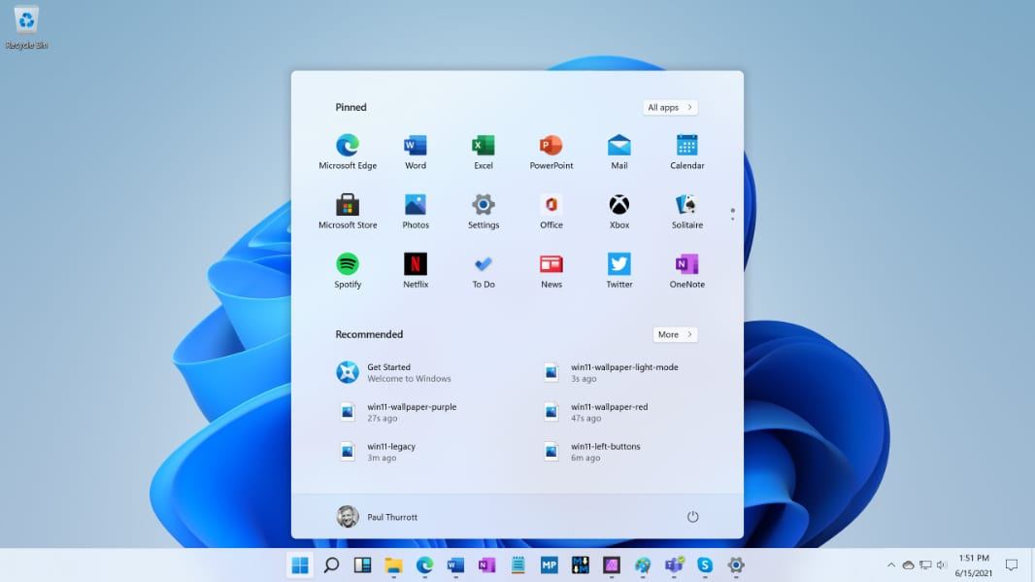
Windows 11
Redesigned Start Menu
Taskbar and System Tray enhancements
Snap Layouts and Snap Groups for improved window management
New Window Management Features
Microsoft Store Redesign
Gaming Enhancements
Enhanced Touch, Pen, and Voice Input
Widgets
Enhanced Performance and Efficiency

Slide 13

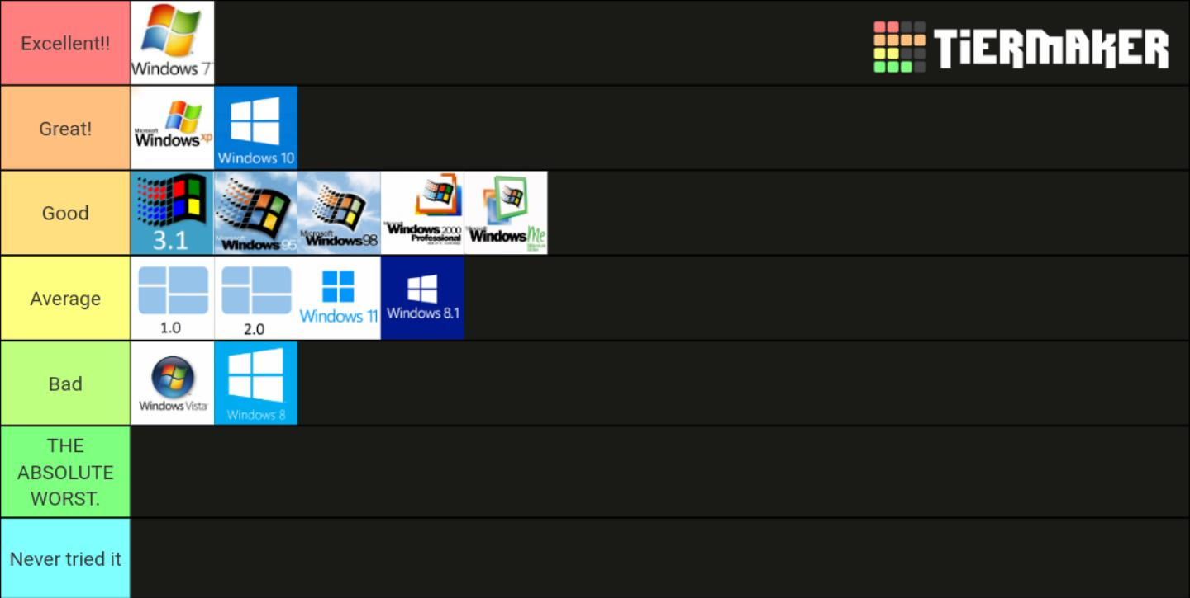
https://www.reddit.com/r/pcmasterrace/comments/txasi5/windows_os_tier_list/

Slide 14

THANK YOU!
Scan the QR Code or go to the link to see/download the project.
https://github.com/SaidulBadhon/hwos

